Slide 1



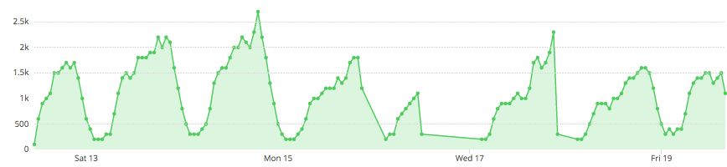
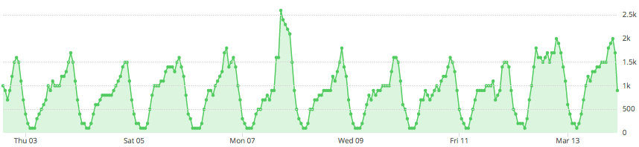
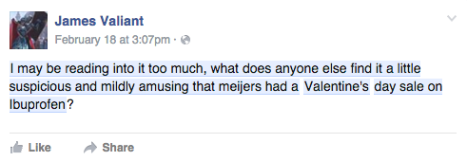
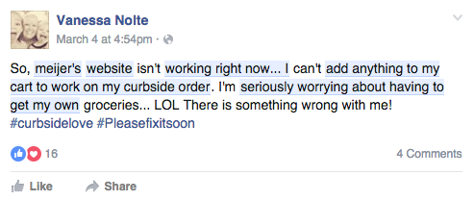
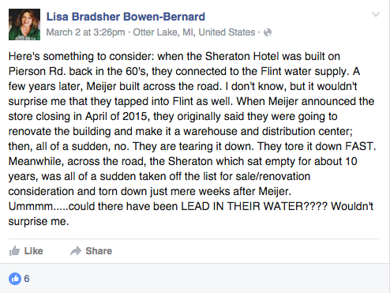
Meijer Facebook Topic Data Insights
Run Dates: 2/12/2016 – 2/19/2016, 3/2/2016 – 3/13/2016
Meijer Insights Summary
PURPOSE: Insightpool aggregated every Facebook interaction relative to Meijer. Insightpool focused of individuals within the Midwest between 2/12/16-2/19/16 and 3/2/16-3/13/16. Insightpool was able to record 431,000 interactions. The purpose of this analysis was to determine the topics that motivate Facebook influencers to talk about Meijer and establish a baseline for those topics for further analysis.
(1) Moms loving the curb: Conversations around Curbside were big enough to pick-up but did not dominate the conversations around Meijer. 6.1K interactions were relative to Meijer’s Curbside. Of that, 93% of the “Curbside” conversations were from females and 42% of the conversations were users ages 25-34. Suggesting new moms are most receptive to Curbside. Most interestingly, is the lack of conversation around Curbside among moms ages 18-24.
Recommendation: The low threshold of conversations amongst young moms (18-24) suggests a larger awareness play around Curbside is needed. Once we’re able to obtain a large enough sample, we will monitor sentiment around the offering to dig deeper into whether consumers are rejecting the service for a particular reason or simply do not know about Curbside.
(2) Meijer upgrades not going unnoticed: Renovations of existing Meijer stores and additions of new stores have led to growing associations with large brands like Walmart.
Recommendation: Avoid being classified as a corporate giant. Emphasize in messaging how the new stores will continue to serve the needs of the local customer in new, innovative ways.
(3) Meijer love in the air on Valentine’s Day: The topic conversation cycle specific to Valentine’s Day started on the 13th at 2 PM EST with 100 interactions until it plateaued at 400 interactions per hour from 10AM EST- 3 PM EST followed by the peak in interactions at 7 PM EST.
Recommendation: Expect increases in conversation around seasonal efforts. We want to dig deeper by looking at each retailer for Memorial Day planning so that promotions team can have more informed data when creating seasonal promotion strategies.
Meijer Conversation Insights
Daily Volume: On average there were more interactions per day on weekends than weekdays
Hourly Volume: The volume of data typically peaked between 7PM and 8PM EST
Valentine’s Day: The largest peak in Meijer conversation was on February 14th due to an association between Meijer and Valentine’s Day.
2/12/16-2/19/16
258,600
Total Interactions
Peak on Valentine’s Day
Unexpected outage of data on February 15th and 16th due to a malfunction of the DataSift notification system
3/2/16-3/13/16
172,400
Total Interactions
Peak on 3/7/16
Peak caused by a “USA Today 10 Best” link associated with Meijer Gardens and Sculpture Park
Valentine’s- Sample Post
Curbside- Sample Post
Renovations- Sample Post

Slide 2
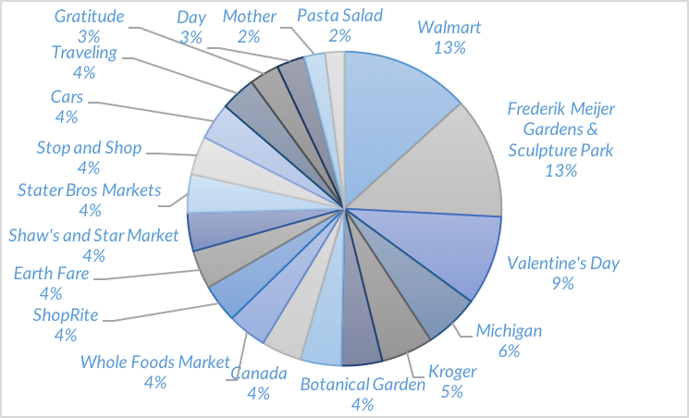
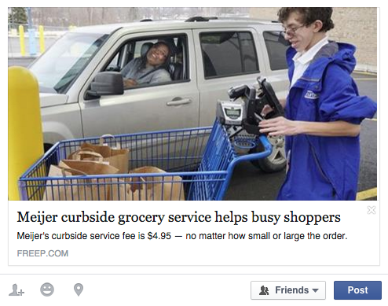
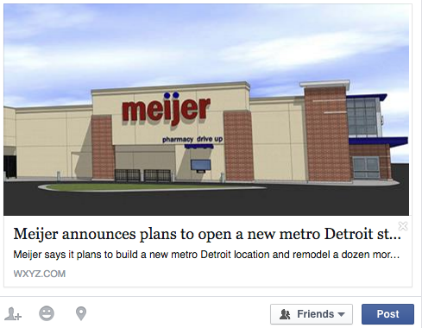
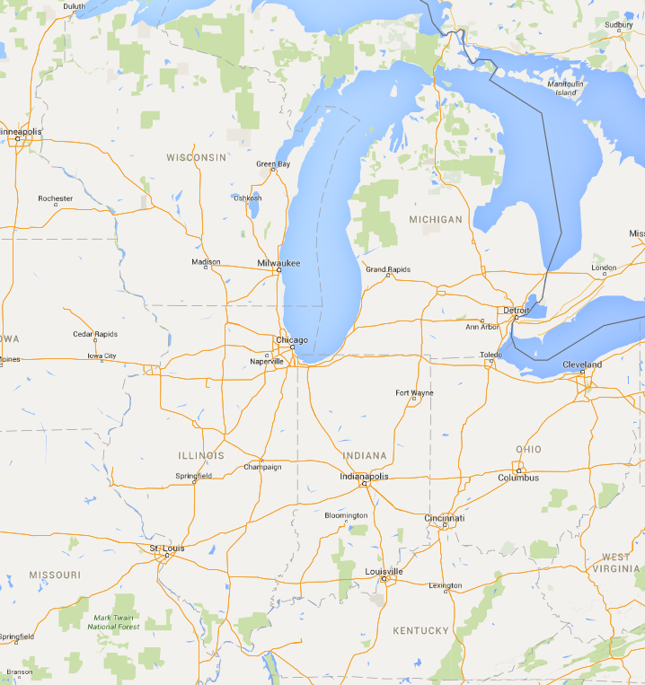
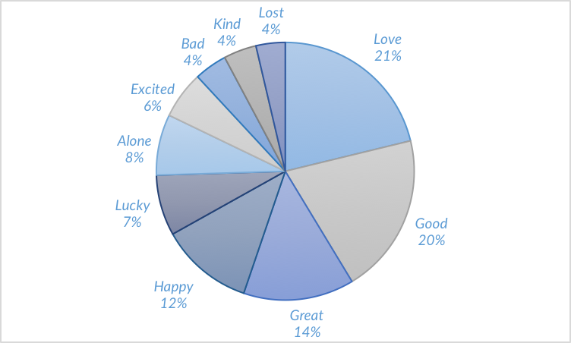
Meijer Facebook Topic Data Insights
Run Dates: 2/12/2016 – 2/19/2016, 3/2/2016 – 3/13/2016
Conversation Insights
Facebook Topic Analysis
Walmart was compared to Meijer more than any other competitor. Of these comparisons, there was 58% negative sentiment towards similarities growing between Meijer and Walmart.
Meijer experienced a spike in conversation around ‘Valentine’s Day’.
‘Cars’ surfaced as a top topic due to negative sentiment around a 9&10 news story about a man touching himself in the parking lot of Meijer.
Top 5 Links
The #1 link came from the Detroit Free Press about Meijer’s Curbside. The interactions from this link came entirely from women and had 100% positive sentiment.
23% - Detroit Free Press- Curbside
20% - mPerks Account
17% - Purchase Agreement
14% - Ohio Newspaper Meijer Buys Property
7% - 12 Store Remodel
Emotional Resonance
Percentage of Interactions Across States
The majority of positive feelings such as “love”, “good” and “great” came from the Baby Department and Photo Services.
2%
63%
7%
13%
13%
3%

Slide 3
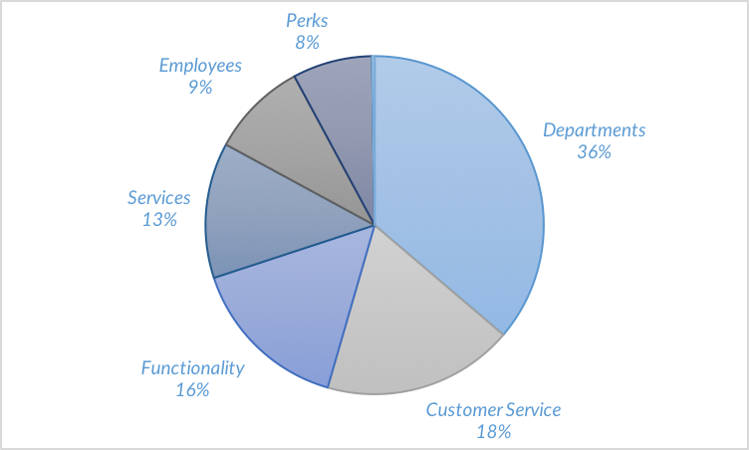
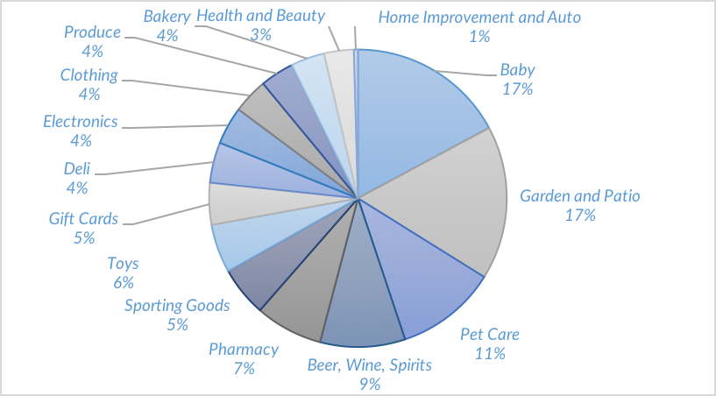
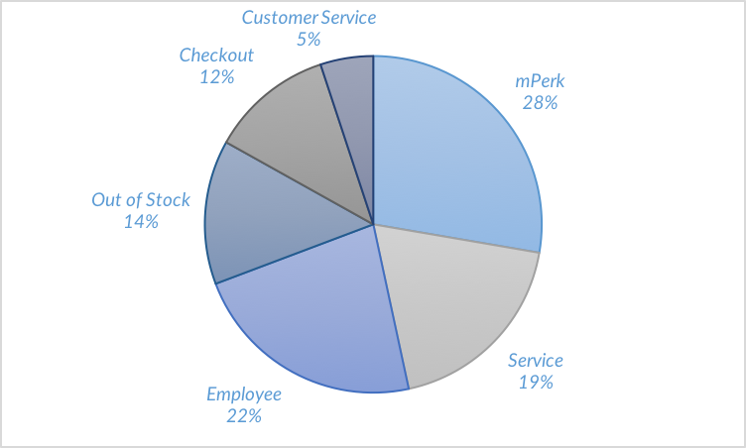
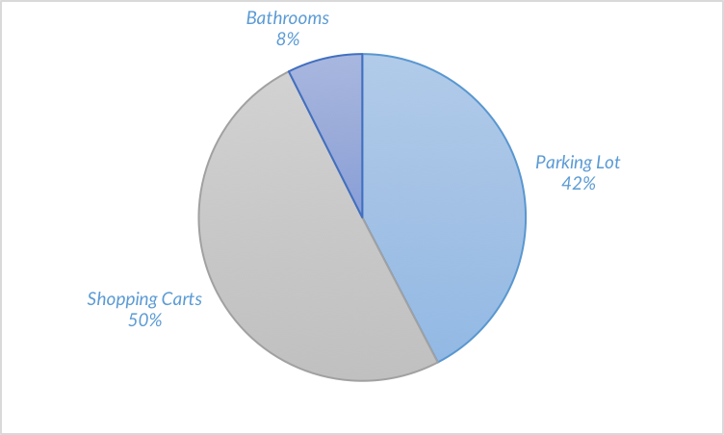
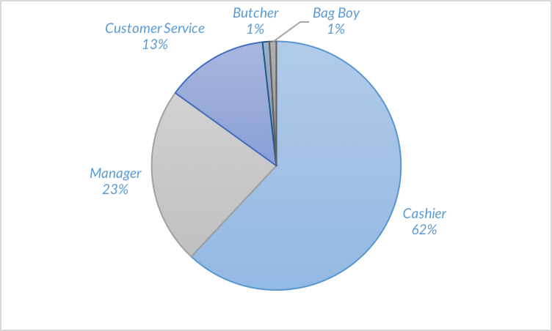
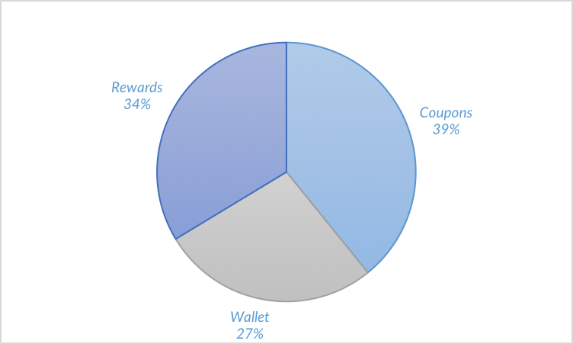
Meijer Facebook Topic Data Insights
Run Dates: 2/12/2016 – 2/19/2016, 3/2/2016 – 3/13/2016
Custom Conversation Insights
Meijer Category Analysis
Topic Dive: Departments
‘Departments’ had a difference of +8% positive sentiment from the index.
Topic Dive: Customer Service
Topic Dive: Functionality
Women put more of an emphasis on customer service in their Meijer conversations.
The negative sentiment associated with functionality is associated with Kroger and Walmart, and centered around the parking lot.
Topic Dive: Employees
Topic Dive: Perks
The conversation about Meijer employees has continued to decrease, particularly about the butcher.
Women over indexed relative to “perks”, and “coupons” bore the most positive sentiment.

Slide 4
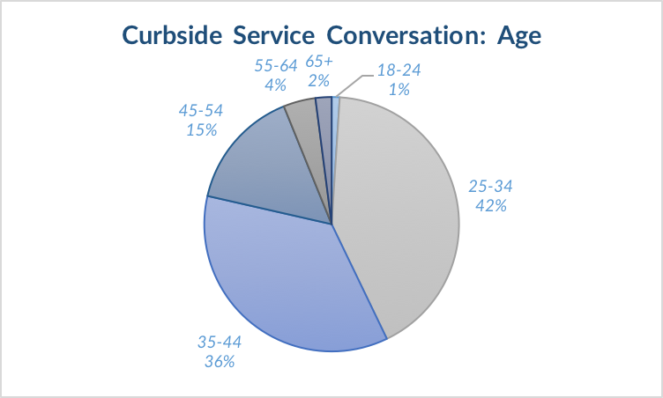
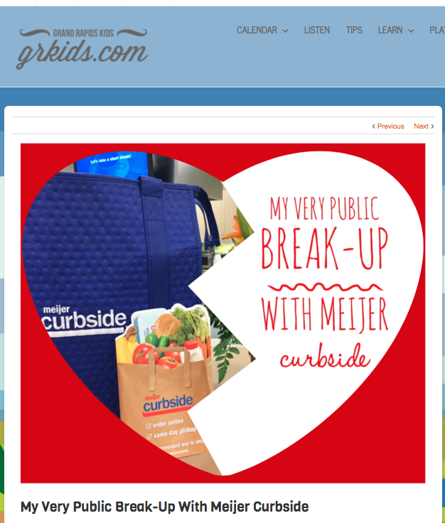
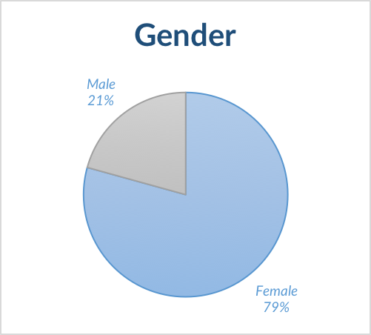
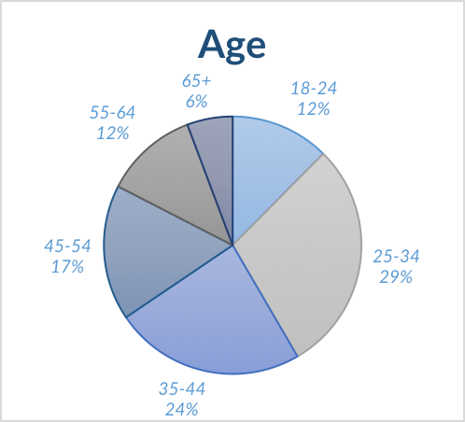
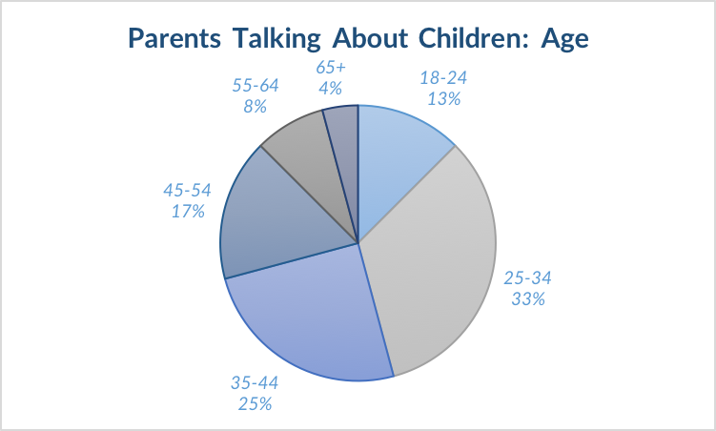
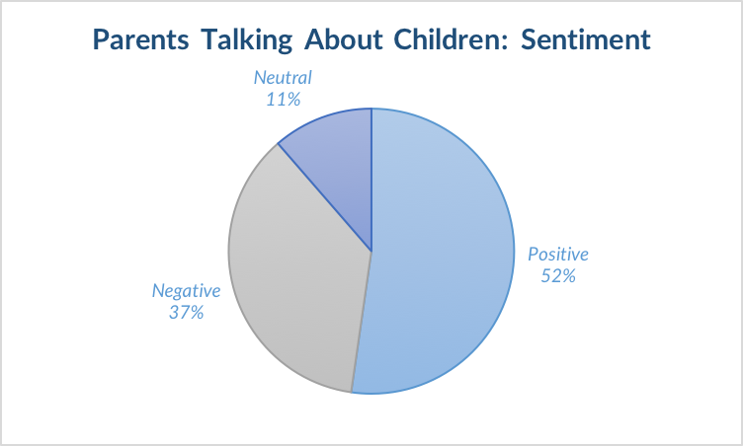
Meijer Facebook Topic Data Insights
Run Dates: 2/12/2016 – 2/19/2016, 3/2/2016 – 3/13/2016
Curbside Breakdown
6,100
Total Interactions
93% of the conversation was from females and 42% was 25-34, suggesting new moms are most receptive to Curbside. However, the service did not resonate with Moms age 18-24.
Two links drove the Curbside conversation. One from the Detroit Free Press and another from grkids.com that discounted Curbside only to replace it with doorstep delivery.
Demographic Insights
Age Overview
18-24
12% of total interactions
8% Baby (Departments)
4% Departments (Categories)
25-34
29% of total interactions
8% mPerks (Customer Service)
9% Shopping Cart (Function)
35-44
24% of total interactions
5% Love (Emotion)
4% Garden & Patio (Depts.)
45-54
17% of total interactions
7% Sculpture Park (Topics)
7% Love (Emotion)
55-64
12% of total interactions
5% Female (Gender)
16% Garden & Patio (Depts.)
65+
6% of total interactions
15% Sculpture Park (Topics)
22% Garden & Patio (Depts.)
Parent Persona Breakdown
Millennial parents’ conversations over indexed relative to their children.
Dealing with children is a huge pain point for parents grocery shopping at Meijer.

